Slide 1
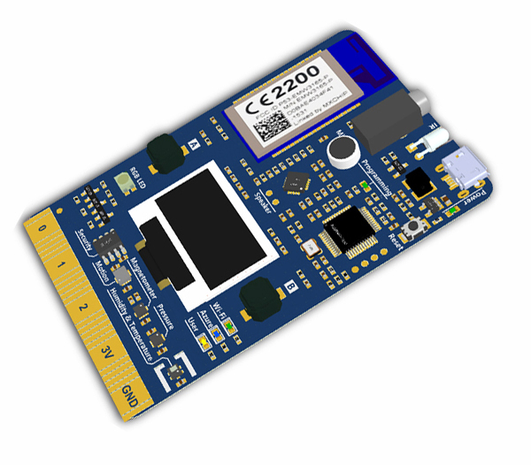
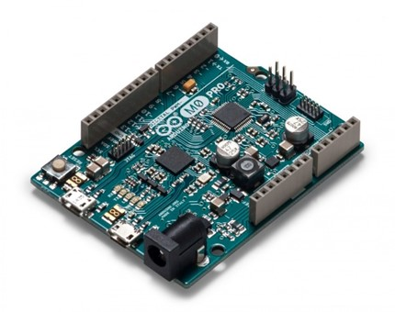
Debugging Arduino projects Dave Glover dglover@Microsoft.com
Slides and Demo Code
http://github.com/gloveboxes in the DebuggingArduino Project

Slide 2
Visual Studio Code With Arduino Extension
Free of charge and Open source
Windows, Mac, Linux
Visual Studio Code
Arduino Extension
HW Debug support
Arduino Board with an Atmel’s Embedded Debugger (EDBG) Chip
JTAG Support (https://en.wikipedia.org/wiki/JTAG) plus SEGGER J-Link EDU - JTAG/SWD Debugger
Examples: Arduino M0 Pro, Arduino Zero, Adafruit Feather M0 Wifi

Slide 3
Atmel Studio 7
Pitched at professional devs
Free of charge
Windows only
Atmel Studio 7
Import Arduino Projects
Arduino M0 Pro Debugging using the built-in EDBG Interface with Atmel Studio 7

Slide 4
Visual Micro
Free of Charge (debugging costs)
Visual Studio Plugin
Free Visual Studio Community Edition
Download from http://www.visualmicro.com

Slide 5
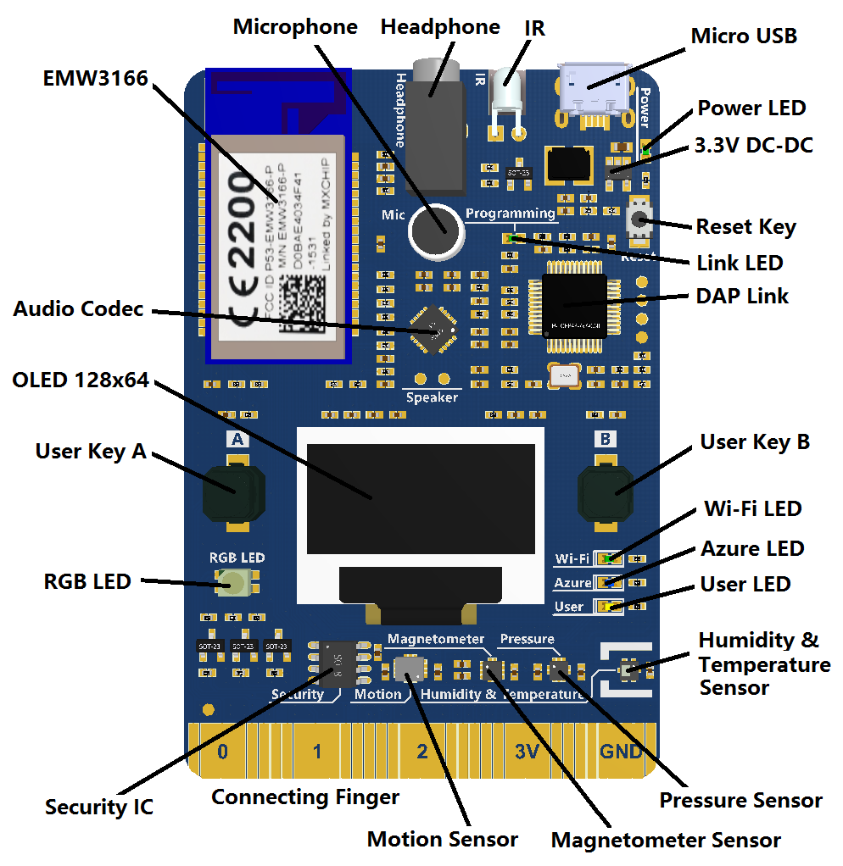
MXChip IoT DevKit
https://aka.ms/iot-devkit
Get Started
Order a Kit
DAP Link EDBG HW Debugger

Slide 6
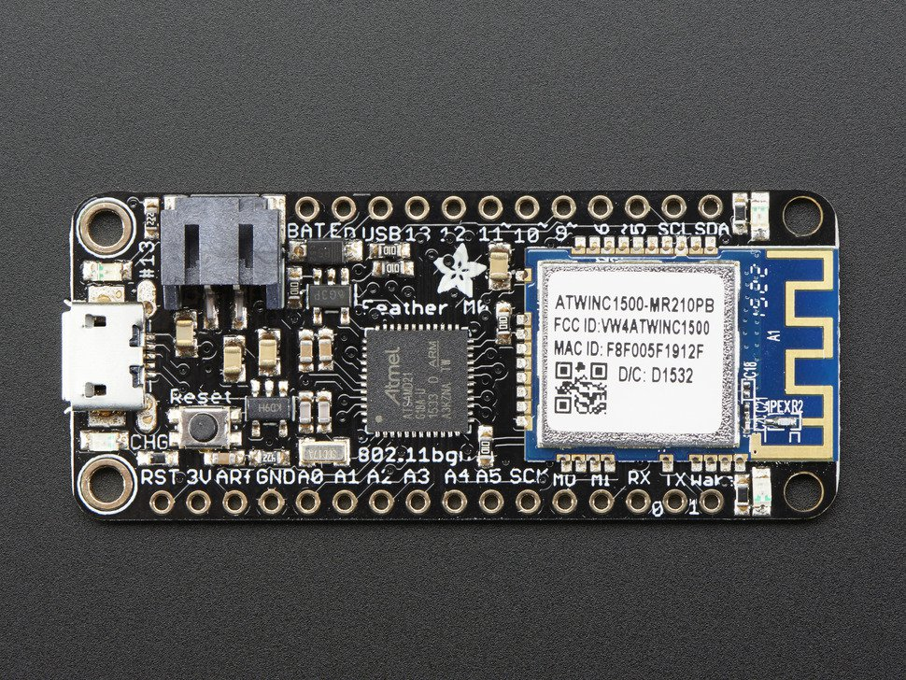
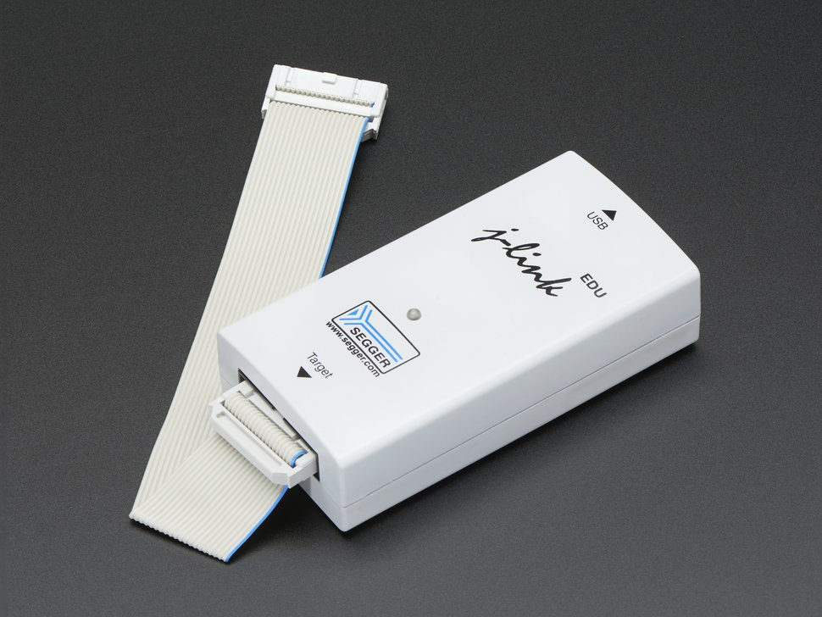
Example Debug Configurations
Arduino M0 Pro (or Zero Pro) with EDBG support
Adafruit Feather M0
Segger J-Link Programmer
https://learn.adafruit.com/make-a-simple-debugging-featherwing-for-the-m0/overview
https://www.adafruit.com/product/1369

Slide 7
Debug your Arduino code with Visual Studio Code
Walk Through
Code Reformat
Break Points and Conditional Break Points
Run to Cursor
Local Watch
Altering Variables
Add Watch
Debug Evaluate
Tip: Disabling Optimisations
http://www.instructables.com/id/Arduino-IDE-16x-compiler-optimisations-faster-code/
#pragma GCC optimize ("-O0")

Slide 8
https://blogs.msdn.microsoft.com/iotdev/2017/05/27/debug-your-arduino-code-with-visual-studio-code/
https://microsoft.github.io/azure-iot-developer-kit/
https://microsoft.github.io/azure-iot-developer-kit/docs/projects/
https://www.google.com.au/url?sa=t&source=web&rct=j&url=http://www.atmel.com/Images/Atmel-42096-Microcontrollers-Embedded-Debugger_User-Guide.pdf&ved=0ahUKEwjFsPjhz4jVAhXGmJQKHSTlBrAQFgglMAE&usg=AFQjCNEznuPZigdEcdsupesPP7lnMVPD-A

